Slide 1

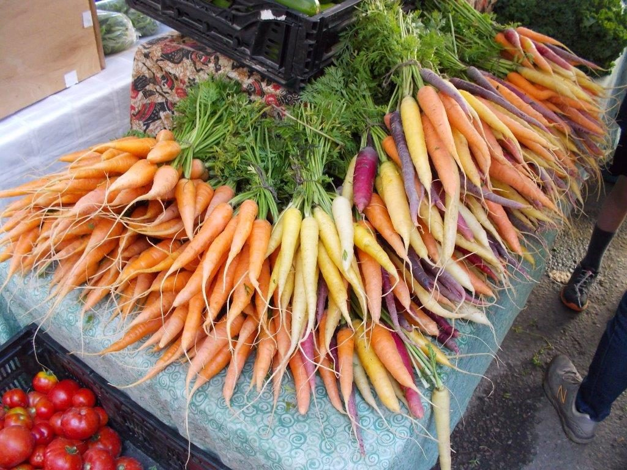


Salad REcipes

Slide 2
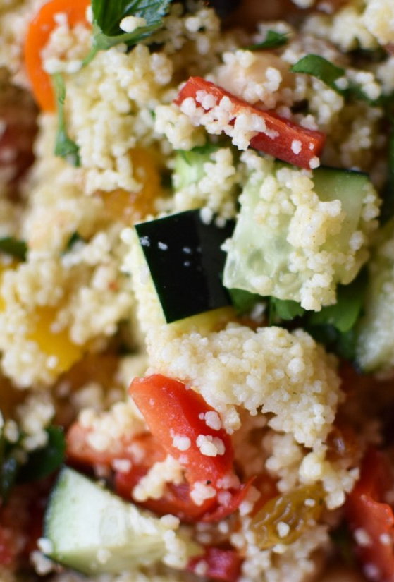




Mediterranean vegetable couscous
1 Aubergine
1 Red pepper
1 Courgette
1 Red onion
75ml Olive oil
Black pepper
300g Couscous
1tbsp Vegetable stock
1 Lemon
1tbsp Basil (chopped)
1tbsp Parsley (chopped)
METHOD
1. Preheat oven to 200°c or Gas 6.
2. Cut aubergine, red pepper, courgette, and red onion into 1cm cubes. Put them all into a roasting tray and mix them with 2 tbsp of the olive oil and season with the black pepper. Spread them out single layer in the tray and cook them for 30-40 minutes turning them once until they are well cooked and browned at the edges. Remove them from the oven and allow to cool.
3. Boil the kettle. Put the couscous into a large bowl. Add 2tbsp olive oil to the couscous and stir to ensure all the grains have a covering of oil (this stops the grains sticking together). Scatter over the vegetable stock. Pour 525ml of boiling water over the couscous and stir briefly with a fork. The water should just cover the couscous. Immediately cover the bowl with a tight layer of cling film sealing it to make sure the steam doesn’t escape. Leave to steam for 5 minutes. Test the grains they should be nearly soft, and all the water has soaked in. fork over the couscous and leave to cool.
4. When the vegetables and couscous have cooled, assemble the salad by tossing them together in a large bowl along with the remaining olive oil, lemon juice and herbs. Season to taste and serve
#HCLfoodies @HCLCatering Facebook Instagram Twitter
This Photo by Unknown Author is licensed under CC BY-NC-ND

Slide 3
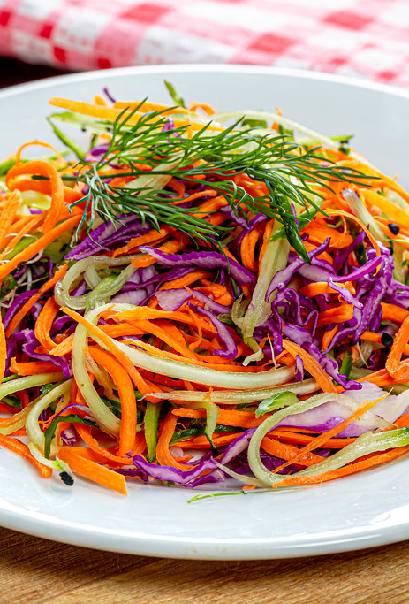


Carrot, Beetroot and cucumber salad
1 Large Cooked cool beetroot
1 Large Peeled Carrot
½ cucumber
2 tbsp Pumpkin seeds
Balsamic vinegar drizzle over
METHOD
Simply spiralize all the vegetables. Using a large bowl add vegetables and pumpkin seeds.
When ready to serve drizzle balsamic vinegar over.
#HCLfoodies @HCLCatering Facebook Instagram Twitter

Slide 4
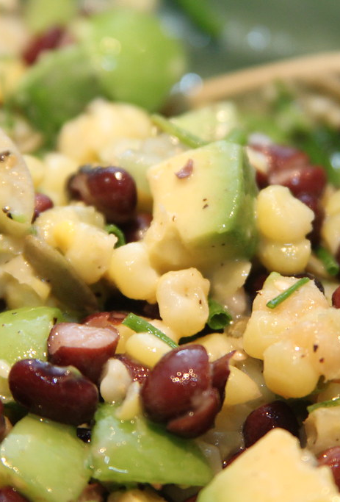


Avocado and three bean salad
1 Black beans (tinned)
1 Kidney beans (tinned)
1 Chickpeas (tinned)
1 Sweet corn (tinned or frozen)
1 Red pepper (diced)
12 Cherry tomatoes (Halved)
3 tbsp Coriander (chopped)
2 Avocado (diced)
2 Lime juice
75ml Olive oil garlic (minced)
Salt and pepper to season
METHOD
After cutting the avocado toss in the lime juice immediately to stop it from turning brown
Wash and drain all beans and sweetcorn (if using frozen cook and cool down).
Mix all ingredients together into a large bowl refrigerate 1 hour before serving
#HCLfoodies @HCLCatering Facebook Instagram Twitter

Slide 5
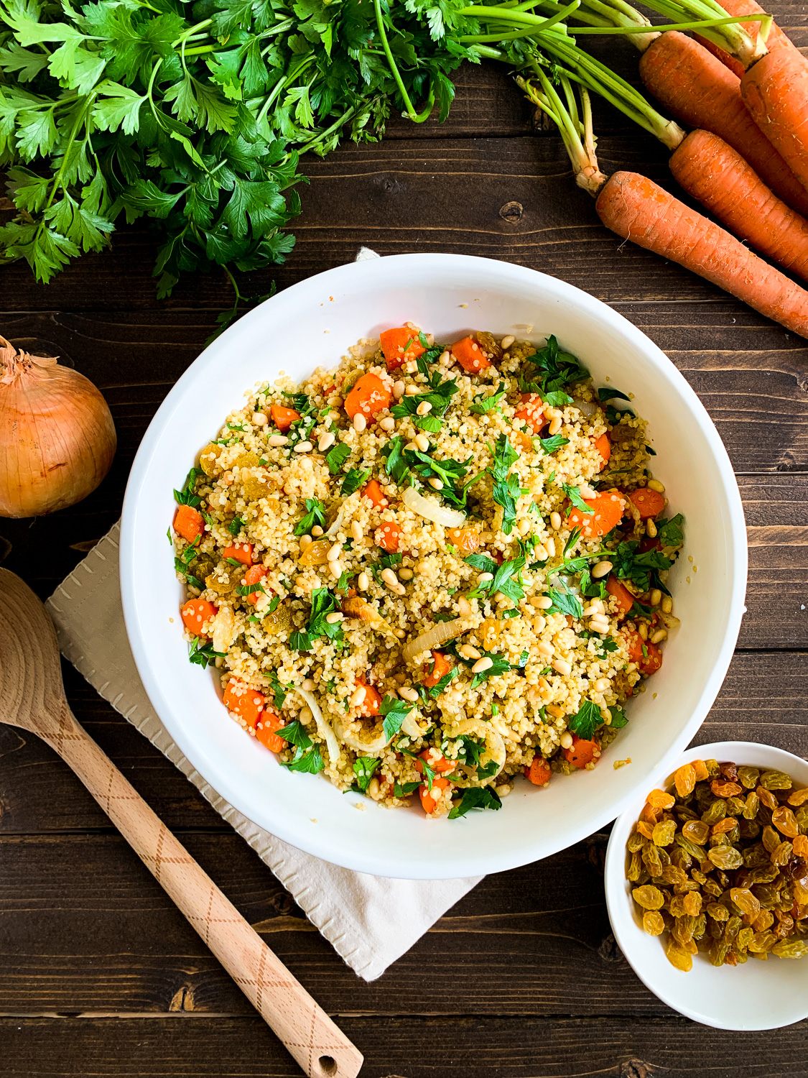
Quinoa SAlad
200g Quinoa
600ml Boiling water
1 large Red pepper
½ Cucumber
150g Cherry tomatoes
1 medium Grated carrot
1 Red onion
1 Chickpeas 400g tin
DRESSING
80ml Olive oil
3 tbsp Lemon juice
2 tbsp Vinegar
80g Parsley(chopped)
50g Coriander (chopped)
2 cloves Garlic (minced)
METHOD
1. Combine quinoa and boiling water in a medium pot, bring to the boil, cover and reduce heat simmer for
15 minutes. Remove from heat and it sit for 10 minutes covered then stir with a fork.
2. Prepare dressing in a mixing bowl stir together olive oil, lemon juice, vinegar, parsley, coriander, and garlic. Chill while you finish the rest of the salad.
3. Wash and drain chickpeas.
4. Dice red pepper, cucumber, and red onion, cut the cherry tomatoes in half. Put them all into a large mixing bowl add grated carrot, chickpeas, quinoa and dressing them stir it all together.
5. Keep chilled until you are ready to serve.
#HCLfoodies @HCLCatering Facebook Instagram Twitter

Slide 6
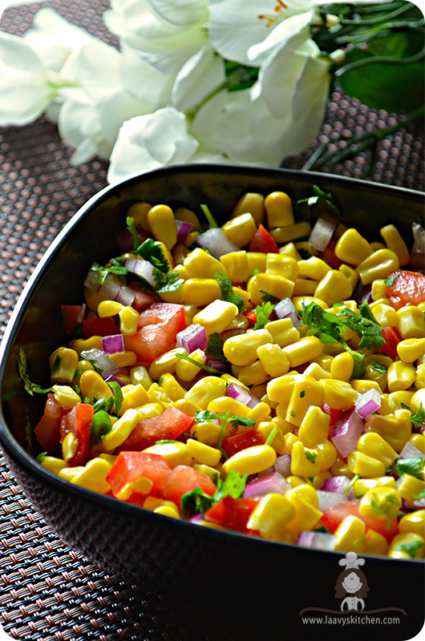
Mexican corn salad
780g Sweetcorn
1 Red onion diced
2 Tomatoes diced
½ bunch Fresh Coriander finely chopped
2 Limes juiced
4 tbsp Olive oil
2tbsp Clear honey
METHOD
1. Cook and cool the sweetcorn.
2. Combine the sweetcorn, onion, tomatoes and coriander.
3. In a separate bowl mix the dressing ingredients together.
4. Coat the salad with the dressing and serve.
#HCLfoodies @HCLCatering Facebook Instagram Twitter

Slide 7
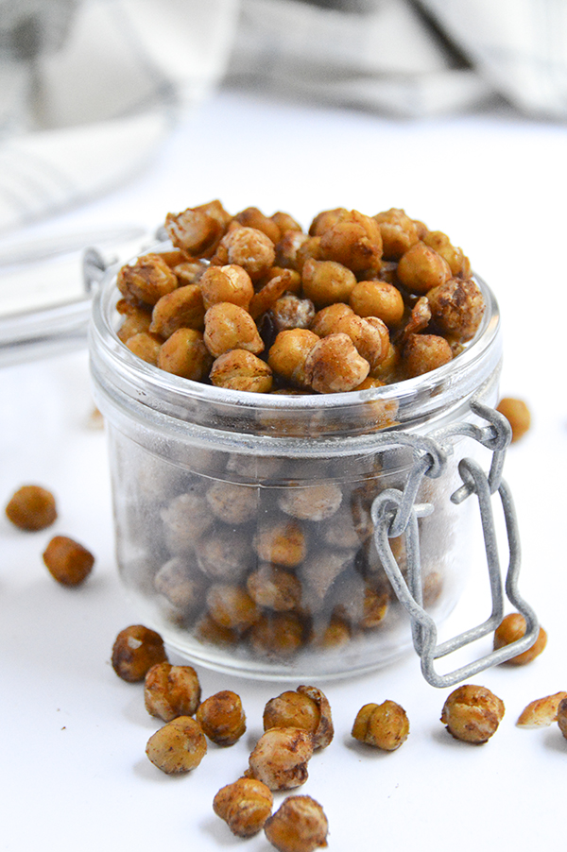
Roasted chickpeas
1 Chickpea 400g tin
1 tbsp Oil
1 tbsp Fajita or barbeque seasoning
METHOD
Preheat oven 180°c or gas 4.
Drain and rinse chickpeas in colander the shake off excess water.
Place chickpeas along with your choice of seasoning and the oil mix together well. Then tip onto a baking tray.
Pop the tray into the oven for 30-35 minutes, checking every 10 minutes to stir. Take the chickpeas out of the oven and leave them to cool.
Store them in an airtight container for up to 1 week.
#HCLfoodies @HCLCatering Facebook Instagram Twitter

